Slide 1



WP Suomi 2026, Oulu, 16th of October, 2026
Going
ACF-free
Replacing a plugin dependency
with core WordPress
Rolle Laukkarinen
Founder and CTO, Digitoimisto Dude Oy
→ rolle.social
Notes:
Hello everyone, I am Rolle from Dude.
This talk is about replacing ACF with core WordPress.
We used ACF for ten years, and only recently moved on to core blocks.
I will share what we learned on the way.

Slide 2



About Rolle
Founder and CTO of Digitoimisto Dude Oy. Code soon
30 years, WordPress since 2005, online since 1999. Accessibility, open source, Linux servers, and building my own tools. Free time: running, bilingual family, knows sign language.
Dude & WordPress
Contributing to WordPress and open source since we founded Dude in 2013: 71 open source repositories on GitHub, including air-light, our starter theme with over 1100 stars.
Going ACF-free
Notes:
Most of you already know me, so I keep this short.
I am the founder and CTO of Dude, and I have built WordPress sites since 2005.

Slide 3
No shame in
using ACF or plugins
WordPress has a great plugin ecosystem, and ACF is a very good plugin.
ACF built a lot of good sites, ours included.
Going ACF-free
Notes:
Nobody gets shamed today for using ACF or plugins.
We used ACF for more than ten years, and it built a lot of good sites.
ACF solved a real problem back when core could not.
Core can do much more today, and this talk is about that.
Nobody here is going to ask who the hell still uses ACF. Not today.

Slide 4
A quick poll
How many of you…
Going ACF-free
Notes:
Ask for hands up on each option.
Get the room to answer before I say anything about going ACF-free.

Slide 5
A quick poll
How many of you…
1
Still use ACF for everything (okay, with exceptions, let’s say 80%)
Going ACF-free
Notes:
Hands up for option 1: ACF on every site, for everything.

Slide 6
A quick poll
How many of you…
1
Still use ACF for everything (okay, with exceptions, let’s say 80%)
2
Use ACF for some things
Going ACF-free
Notes:
Hands up for option 2: ACF for some things, core blocks for the rest.

Slide 7
A quick poll
How many of you…
1
Still use ACF for everything (okay, with exceptions, let’s say 80%)
2
Use ACF for some things
3
Have fully moved on to native, React or core Gutenberg blocks
Going ACF-free
Notes:
Hands up for option 3: ACF is legacy, and you have moved on to native or core blocks.
Say the split out loud. It shows how much of this talk is new to the room.

Slide 8
What is a dependency?
“A situation in which you need something or someone and are unable to continue normally without them.”
Cambridge Dictionary
Going ACF-free
Notes:
I could talk for hours about dependencies, so we start with a definition.
WordPress itself is a dependency too.
A site depends on the host, Linux, the web server, PHP, the database, WordPress, the theme, the plugins and outside services like DNS and email.
A site always has dependencies, so the goal is to choose them on purpose.
A good dependency has an open licence, can be replaced, keeps your data in a standard format and outlives the site.
WordPress core passes all four: GPL, over 20 years old, thousands of contributors and plain database tables.
A plugin owning your content format does worse on every check. ACF is that kind of plugin.

Slide 9
A brief history of
fields and dependencies in WordPress
Going ACF-free
Notes:
First a short look back.
Fields come first, then dependencies, then Gutenberg.

Slide 10
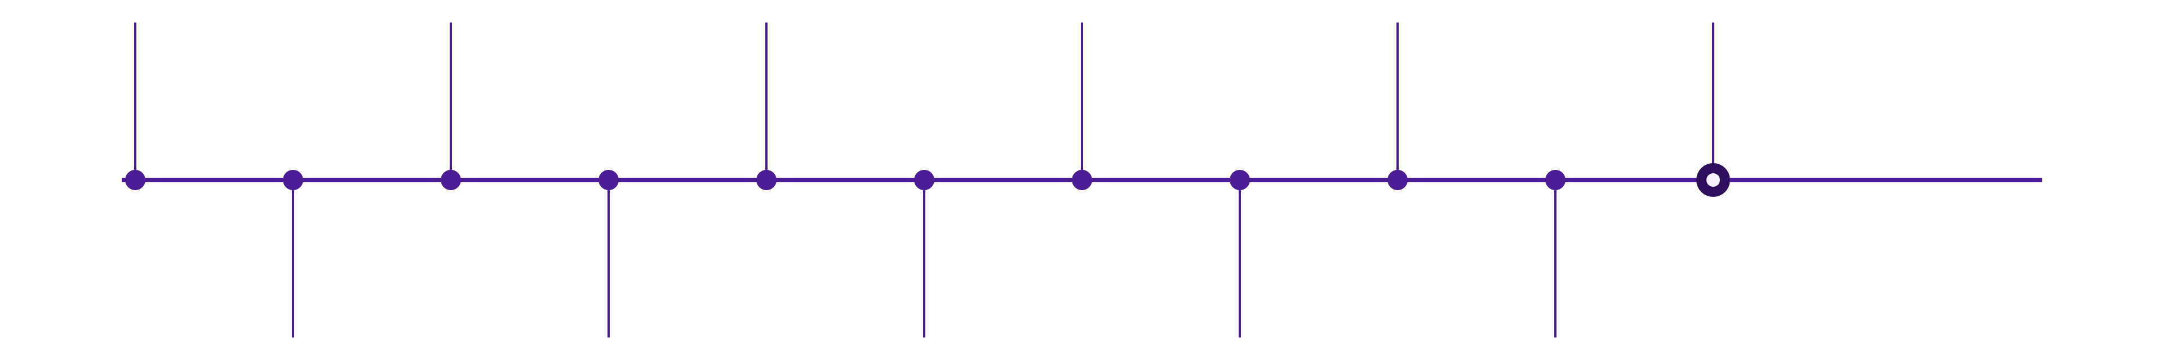
Fields since 2004
2005
2011
2018
2021
2024
2026
My first WordPress
ACF
WordPress 5.0
WordPress 5.8
ACF is forked
WordPress 7 ->
custom fields in core
ACF’s first commit
Gutenberg and React
theme.json, block.json
Bindings land in 6.5
Going ACF-free
2010
2014
2019
2022
2025
WordPress 3.0
dudestack
ACF Blocks
ACF to WP Engine
WordPress 6.9
custom post types
ACF from commit one
fields inside blocks
via Delicious Brains
Native blocks at Dude
Going ACF-free
Notes:
Custom fields have been in core since WordPress 1.2 in 2004. I started with WordPress in 2005.
2010: WordPress 3.0 brings custom post types.
2011: ACF gets its first commit.
2014: our starter stack dudestack required ACF from its first commit.
2018: WordPress 5.0 ships Gutenberg, built on React.
2019: ACF Blocks put fields inside blocks.
2021: WordPress 5.8 brings theme.json and block.json.
2022: WP Engine buys ACF.
2024: Block Bindings arrive in 6.5, and ACF is forked as Secure Custom Fields.
2025: WordPress 6.9 gives bindings a real UI, and we build our first native blocks at Dude.
2026: WordPress 7.

Slide 11

First there were
Advanced
Custom fields
What is a field, anyway?
We are talking about fields, right?
Going ACF-free
Notes:
ACF means Advanced Custom Fields. Drop the word Advanced and you get plain custom fields.
Core has had custom fields since 2004.
A field is a named value on a post: a key and a value in wp_postmeta.

Slide 12


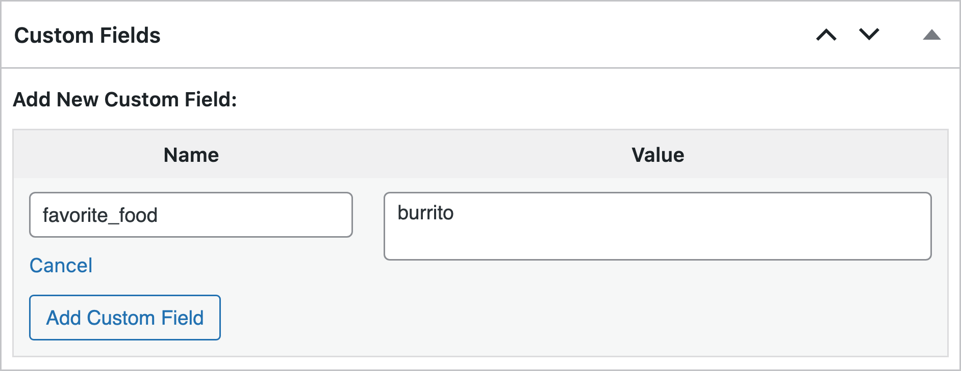

Let’s go back to
prehistoric times…
No dependencies?
Let’s knife the database!
—
In the early days, some of us used plain meta fields, and it was enough.
—
For a developer, get_post_meta() is fine. It is a knife straight into a row.
—
Once clients edit content themselves, they need a proper editing interface. Also, text fields are way too limited.
Going ACF-free
Notes:
This is a bit of a joke, but it is real history.
We used to build sites with meta fields only, back when WordPress was a blogging tool.
Meta fields work fine for a developer. It feels like knifing the database.
A client needs a real system to update content easily.
If asked: the box only ever did text. wp_postmeta stores every value as a string, with no type column.
If asked: featured images arrived in WordPress 2.9 in 2009 and took over the main job of the box. That explains the best before 2009 stamp.

Slide 13
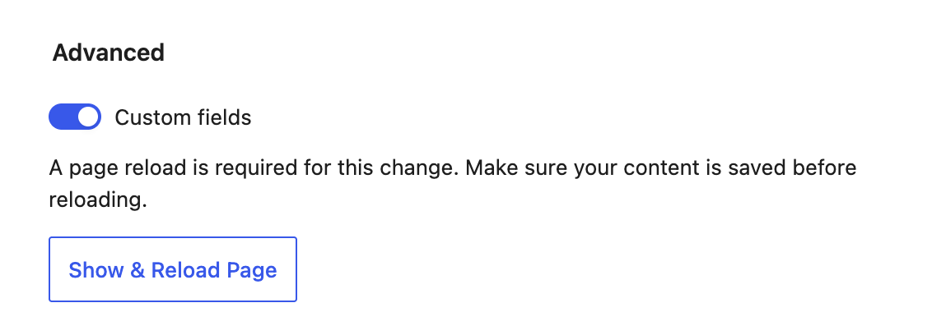
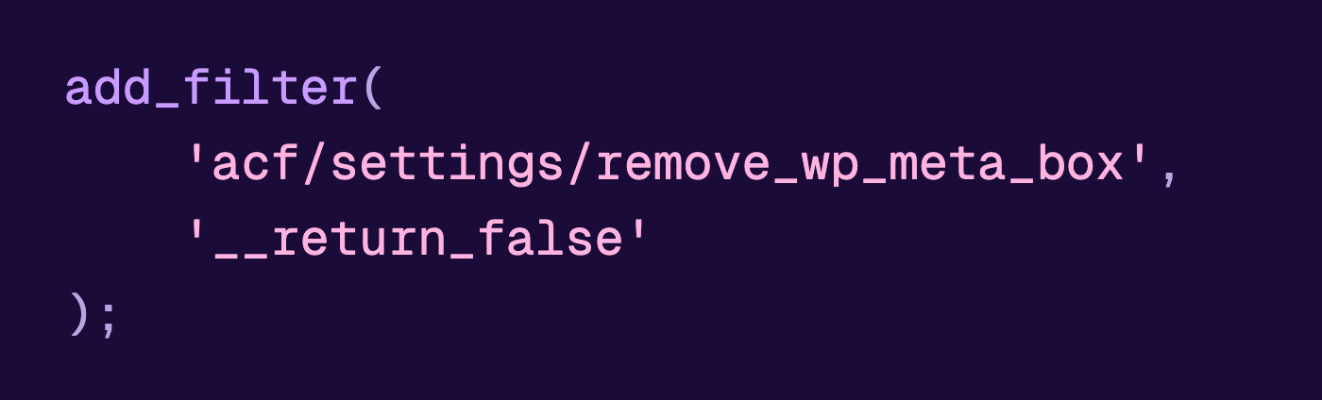

Using (prehistoric) custom fields
Turn them on
ACF actually disables them
Options (three dots), Preferences, General, Advanced, Custom fields. The editor reloads.
ACF removes the Custom Fields box by default, so on an ACF site the toggle is not there at all. One filter brings it back.
Hidden in Preferences since 2018. Bring a shovel.
Going ACF-free
Notes:
A fun aside. I do not recommend this box for client sites.
To turn it on: Options, Preferences, General, Advanced, Custom fields. The editor reloads.
ACF hides the box by default. The ACF filter on the slide brings it back.
ACF hides it because the box runs a slow query over the whole wp_postmeta table.
The box only does text. Keys are typed by hand, so Photo credit and photo_credit become two different fields.
Today register_post_meta() and Block Bindings do the job properly.
The 100% dependency-free stamp is true. No plugin is involved.

Slide 14
Advanced Custom Fields
since 2011
ACF was born to extend custom fields.
Better fields, but still fields.
We are past the field era and into the block era.
Going ACF-free
Notes:
ACF got its first commit on 28.3.2011.
ACF made custom fields usable with field types, a real UI and repeaters.
Everything ACF adds is still a field in wp_postmeta, printed by a template.
Blocks changed the unit of content from a field to a block. This talk is about that change.

Slide 15
We thought we did “the core way”
Underscores, 2016
Core functions
air-light started from Automattic’s starter theme,
a traditional theme kept as close to core as we could.
Templates built from WordPress’s own parts: the loop, template parts, WP_Query.
ACF on every site
Why we kept doing ACF
The content in those templates came from ACF fields. That is not the core way.
ACF was quick to build with, and the sites built on it kept working for years.
Going ACF-free
Notes:
I have always liked the core way of WordPress. air-light started from Automattic's Underscores in 2016.
We felt we did things the core way, but we still used ACF. With ACF it is not the core way.
You do not want to be a purist. You want something fast to build that works for years.
ACF was that, until it wasn't.
air-light still ships no blocks, on purpose. For a long time I saw blocks as a dependency too.
If asked: our first native block code in air-light is from 28.2.2025.

Slide 16

So what’s
the answer?
When we finally went native in 2025,
we thought we knew.
Going ACF-free
Notes:
For years our answer was Gutenberg for articles and ACF for everything else.
In 2018 I did not even have time to test Gutenberg properly.
When we went native in 2025, we thought blocks meant React. So we coded every block ourselves, with every option in React.
The GIF is Deep Thought from The Hitchhiker's Guide to the Galaxy. The answer was 42, and just as useful.

Slide 17

We thought “native” meant React.js
2018 to 2024
2025
We used core Gutenberg for articles, ACF for everything else.
ACF Gutenberg blocks since 2021.
Our first real native blocks:
every option written by hand in React.
One site, when we still stumbled
The result
23 custom blocks, 77 attributes, about 3000 lines of edit.js JavaScript.
Too static blocks, “reinventing the wheel” like with ACF…
Going ACF-free
Notes:
2017: we added the Classic Editor to our stack to prepare for Gutenberg.
2018 to 2020: Gutenberg for articles only. Pages stayed on ACF.
2021: ACF blocks became our standard.
In 2018 a custom block needed JavaScript and a build step. PHP developers did not want to write React, so ACF Blocks, Block Lab and Lazy Blocks appeared.
2025: our first native blocks, with every option written in React.
The peak was one client site in 2026: 23 custom blocks and about 4,130 lines of JavaScript.
Markup coded into the blocks hurt the most. A pattern could not drop the buttons, because the buttons were in the code.
From 5.2026 that site moved to core Group blocks and patterns.

Slide 18


-devs
And suddenly we were
2012
Flashback, historical hard pass
Underscores. PHP, HTML and CSS. Where I learned themes, and where I stayed for the longest time.
Sage, Twig, Timber, Blade, Dust.js, exotic ways of building WordPress. I kept at doing traditional WordPress.
2017
2018
WordPress nearly dropped React over its patent clause. Facebook relicensed it as MIT.
Blocks are React components, built with npm and @wordpress/scripts.
Going ACF-free
Notes:
I am a traditional WordPress developer. I come from Underscores, with PHP, HTML and CSS.
I never got into Sage, Twig, Blade or other templating languages.
Then WordPress took a huge leap and moved to React.
Learning React still paid off. It taught us how the block editor works, and now we can tell when a custom block is really needed.

Slide 19


Media and text, coded by hand
blocks/media-text/
├── block.json
├── build/
└── src/
├── index.js
├── edit.js
├── save.js
├── deprecated.js
├── editor.scss
└── style.scss
const { heading, level, mediaUrl,
mediaRight, bgColor, padding } = attributes;
<InspectorControls>
<SelectControl label="Heading level" value={ level } />
<ToggleControl label="Media right" checked={ mediaRight } />
<ColorPalette value={ bgColor } onChange={ setBg } />
<RangeControl label="Padding" value={ padding } />
</InspectorControls>
<RichText tagName={ level } value={ heading } />
<MediaUpload onSelect={ setMedia } render={ button } />
Every one of these controls already ships with core Media & Text, in core since WordPress 5.0 (2018).
Going ACF-free
Notes:
This is the media and text block coded by hand, the way we built blocks in 2025 and 2026.
Nine files. Every option needs an attribute in block.json and a control in edit.js.
save.js must print the same HTML as the database, or the editor marks the block invalid.
The core Media & Text block already has all these controls. It has been in core since WordPress 5.0 in 2018.
Our sidebar text fields lost bold text, links and lists.
We maintained all this code ourselves, while core maintains the same block for free.
Since 2021, theme.json can style the core Media & Text block fully, with no code.

Slide 20
React is for
WordPress core developers
The WordPress block editor itself is built with React.js.
Themes, patterns, styles and theme.json need none of it.
React only comes in for a custom block, and that's the last resort.
Going ACF-free
Notes:
The block editor is built with React. React is for the people building WordPress core.
Themes, patterns, block styles and theme.json need no React. They are HTML and JSON.
You can build custom blocks without JSX or a build step.
On the front end, the Interactivity API works without React.

Slide 21
True dependency-free WordPress
is the core way
The WordPress block editor (also called simply the block editor,
WordPress editor or Gutenberg editor) as the content management system,
with no plugin that the content depends on.
Going ACF-free
Notes:
Jokes aside, dependency-free here means no plugin owns the content.
WordPress itself is the one dependency we choose on purpose.
The rest of the talk shows our route away from ten years of ACF.

Slide 22




Three ways to build a sovereign theme
Traditional
Innovative
Modern
_s/
├── style.css
├── functions.php
├── header.php
├── footer.php
├── index.php
├── single.php
├── page.php
├── template-parts/
│ └── content.php
└── inc/
sage/
├── app/
│ └── View/Composers/
├── resources/
│ ├── views/
│ │ └── index.blade.php
│ ├── css/
│ └── js/
├── composer.json
├── package.json
└── vite.config.js
block-theme/
├── style.css
├── theme.json
├── functions.php
├── templates/
│ ├── index.html
│ └── single.html
├── parts/
│ └── header.html
├── patterns/
└── styles/
Underscores, 2012. PHP templates and the template hierarchy.
Sage by Roots. Blade, Composer and a build step on top of WordPress.
Block theme, WordPress 5.9. HTML templates and theme.json.
Going ACF-free
Notes:
I stuck to PHP, HTML and CSS and the core way. The core way avoids vendor lock-in, and it feels good to build things the way core intended.
Traditional: Underscores from Automattic, launched in 2012. PHP templates and the template hierarchy.
Innovative: Sage by Roots, started in 2011. Blade views, Composer and Vite.
Modern: block themes since WordPress 5.9 in 2022. HTML templates and theme.json, edited in the Site Editor.

Slide 23






From Traditional to Modern
Traditional
Modern
PHP templates
HTML templates
ACF fields
Block parts
post meta
ACF blocks
theme.json
native blocks
5.8+
6.1+
style.css
Post meta
theme.json
jQuery/Vanilla JS
Native blocks
6.5+
Interactivity API
WP REST API
5.0+
AI client
hybrid theme: every step works in a classic theme
Going ACF-free
Notes:
You do not have to jump in one go. Every step works inside a classic theme, and that makes a hybrid theme.
Step 1: replace ACF blocks with core blocks, patterns and your own blocks.
Step 2: replace ACF fields with register_post_meta() and Block Bindings.
Step 3: add theme.json to the classic theme.
Step 4: add block template parts for the header and footer.
The last step is a full block theme with HTML templates.
A hybrid theme is a fine place to stop.
If asked about full site editing: block themes had 8.3% of non-default theme installs in June 2026. Classic themes still win about 11 to 1.
If asked: templates edited in the Site Editor are saved to the database and drift from git.

Slide 24
Going 100% core: pros
—
Performance, things moving from server to browser
—
Heading levels, colours and spacing are built in.
—
The client edits in the preview itself.
—
Lego and Duplo at once, mixed freely.
—
Anything can be moved, reordered and combined.
—
The client gets a real tool. One client had called an
old site “the WordPress straitjacket Dude knitted”.
Going ACF-free
Notes:
Performance: work moves from the server to the browser. The next slide shows the difference.
The basics are built in: heading levels, colours and spacing. With ACF, even changing an h1 to an h2 was a job for a developer.
Our editors could not add bold text or a link in the middle of a sentence in the ACF WYSIWYG field.
The client edits in the preview. Our big ACF blocks flickered every time you touched them.
Lego and Duplo at once: big and small pieces, mixed freely.
A client once called an old site "the WordPress straitjacket Dude knitted". He was half joking.

Slide 25


Content in ACF and in core
DATABASE + acf-json/
PLUGIN
THEME
DATABASE
With ACF
Field groups
→
ACF
→
PHP templates
→
Field values
Set up by hand in the admin
Reads the groups, draws the forms
Print each field with get_field()
One wp_postmeta row per field
WORDPRESS CORE
THEME
DATABASE
With core blocks
Blocks
→
No plugin
→
theme.json
→
Content
The options come with the block
Nothing to install or update
Colours, sizes, spacing, styles
Block markup in post_content
Going ACF-free
Notes:
With ACF, things live in four places: field groups in the database, the ACF plugin, PHP templates and wp_postmeta.
Lose the database and you lose the field groups. ACF added Local JSON in 2014 to copy them into the theme for git.
Many of us built field groups in code instead, with acf_add_local_field_group() or ACF Codifier. That adds one more dependency on top of ACF.
With core blocks there are three places and no plugin: the block in core, the styles in theme.json and the content in post_content.
There are no field groups to set up. The block is the field.

Slide 26
From server to browser
VISITOR
CACHE
THEME
DATABASE
With ACF
Page request
→
Page cache
→
PHP renders
→
Field values
Asks for a page
A hit ends here
Every block, on every cache miss
Read one field at a time
VISITOR
CACHE
DATABASE
BROWSER
With core blocks
Page request
→
Page cache
→
Saved HTML
→
REST API
Asks for a page
A hit ends here
Block markup is already in the page
Fetches only the live parts
Going ACF-free
Notes:
With ACF, PHP renders every block on every cache miss and reads the fields one at a time from the database.
With core blocks, the block markup is already saved in the page, so there is nothing to build.
Only the live parts, like a job listing, fetch data from the REST API in the browser.
A cache hit ends the request in both cases.

Slide 27
Going 100% core: the “cons”
—
A steep learning curve for the whole team.
—
Less PHP, more JSON: theme.json, block.json.
—
Unlearning building every block from scratch.
—
Heavy build tooling: React, npm, a build step.
—
Core moves fast, and the docs are scattered.
Going ACF-free
Notes:
The cons: a steep learning curve for the whole team.
Less PHP and more JSON, in theme.json and block.json.
Old habits to unlearn: we used to build every block from scratch.
Heavy build tooling for custom blocks: React, npm and a build step.
Core moves fast, and the docs are scattered.
I said this would take our team a year or more to absorb. It is wonderful and horrible at the same time.

Slide 28

The designer’s new job
We used to design the limits: fixed layouts the client could only fill in.
Core gives the client every block, in any order, next to anything.
Every block needs to look like the brand, in every combination.
Going ACF-free
Notes:
Designers used to limit the client. Now the client gets full freedom.
Every block has to look like the client's brand in any combination.
With great power comes great responsibility.
The design system lives in theme.json, block styles and patterns. We lock the parts that must not change.
We give as many choices as we can and make them all look good.

Slide 29
The leap is high,
and that is not your fault
Since WordPress 5.0 in 2018, Gutenberg has added
many ways to build sites without dependencies. And it has been a ride.
Going ACF-free

Slide 30
Ways to build a block
—
Core blocks, as shipped
—
register_block_type in PHP
—
acf_register_block_type
—
Core block variations
—
registerBlockType in JS
—
ACF blocks via block.json
—
Block patterns
—
block.json metadata
—
Hybrid ACF and native
—
Block styles
—
Dynamic block with render.php
—
Classic theme, core blocks
—
Filtering a core block in PHP
—
Custom React block
—
Block theme, full site editing
—
Filtering a core block in JS
—
Custom block with InnerBlocks
—
Block Bindings
—
Synced patterns
—
Interactive block, Interactivity API
—
3rd party page builders
Going ACF-free
Notes:
There are 21 ways to build a block. No wonder moving off ACF feels confusing.
You do not need all of them.
Column 1 needs no custom code: core blocks, variations, patterns, styles and synced patterns.
Column 2 is your own code: block.json, render.php, React, InnerBlocks and the Interactivity API.
Column 3 has the in-betweens and third parties: ACF blocks, Block Bindings and page builders.
Elementor stores layouts as JSON in post meta, so the content needs the plugin. Same problem as ACF, only bigger.

Slide 31
From core to custom, prioritized
1. Core blocks
2. Patterns
WordPress 7.1 ships 115 of them, including accordion, tabs and details.
Core blocks arranged into a layout that editors insert and edit freely.
3. Variations and styles
4. Custom blocks
A core block with your own defaults or look, in a few lines of code.
block.json and render.php when nothing in core fits, with InnerBlocks inside.
Going ACF-free
Notes:
Go in this order: core blocks, then patterns, then variations and styles.
Write a custom block only when nothing above fits.
If asked: 115 is the core block count in WordPress 7.1.

Slide 32

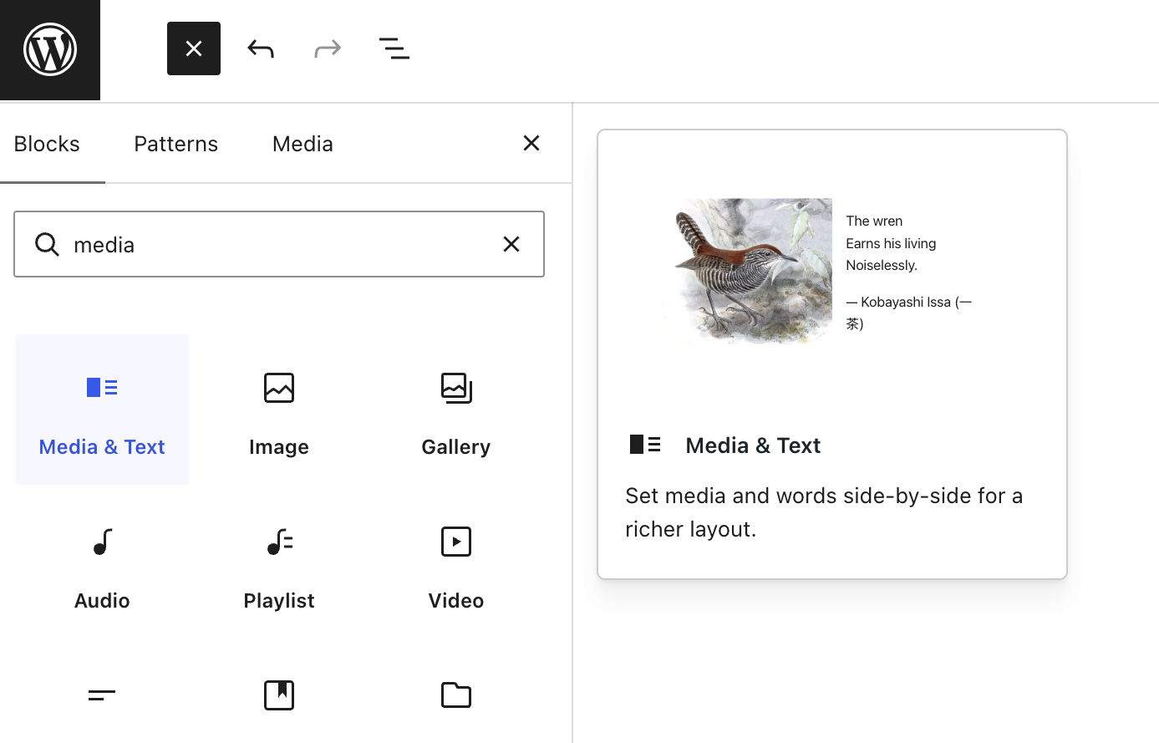
Block example: Media and text
With ACF
With the core Media & Text block
$title = get_field( 'title' );
$content = get_field( 'content' );
$image = get_field( 'image' );
$link = get_field( 'link' );
?>
<section class=“block block-content-image">
<h2><?php echo esc_html( $title ); ?></h2>
<?php echo wp_kses_post( $content ); ?>
<p>
<a href="<?php echo esc_url( $link['url'] ); ?>”>
<?php echo esc_html( $link['title'] ); ?>
</a>
</p>
<?php native_lazyload_tag( $image ); ?>
</section>
Going ACF-free
Notes:
The same block, built two ways.
Left: our most recent ACF site, launched in 5.2026. The editor fills a fixed form with a title, a text box, a link and an image.
Every new variation needs a developer to add a field.
Right: the core Media & Text block, in core since WordPress 5.0. There is nothing to build.
The client can put any blocks inside it, like headings, lists and buttons.
theme.json and block styles handle the look. A pattern file gives editors a ready starting point.

Slide 33
Most of the time
you don’t need to code a block
WordPress 7.1 ships 115 core blocks,
and most layouts are a core block, a pattern or a block style,
set up in the editor and in theme.json.
Going ACF-free
Notes:
Search the inserter first. The core block often already exists.
One of our 2026 sites has zero custom blocks: core blocks, three block styles, theme.json and patterns.

Slide 34

When you do code: the Dude House Way
1
Lock theme.json first: palette, type scale, spacing…
blocks/events/
├── block.json
├── build/
└── src/
├── index.js
├── edit.js
├── view.js
└── style.scss
2
Core blocks, curated per post type.
3
Style core blocks and their variations in theme.json
4
Layouts as patterns, built from core blocks.
5
Public data from the WP REST API, rendered in the browser.
6
Interactivity API for filters and paging.
7
Custom blocks only as the last resort.
Going ACF-free
Notes:
When we do write code, we follow this order at Dude.
1. Lock theme.json first: palette, type scale and spacing. The client picks from our scale.
2. Core blocks by default, curated per post type.
3. Style core blocks in theme.json. SCSS only for the rest.
4. Layouts are patterns. We deleted custom blocks that were only layout.
5. Public data comes from the REST API and renders in the browser. We avoid render.php.
6. Interactive parts use the Interactivity API. No React on the front end.
7. A custom block is the last resort.
ACF is still installed on these sites, but it builds no blocks. It handles data forms like settings screens.
If asked: some of our current blocks still use render.php, and we are moving away from it.

Slide 35
Site Editing/Block theme: our first build
Templates and parts
Patterns in files
Page templates, header and footer as HTML files, declared in theme.json.
Reusable sections as pattern files, versioned in git with the theme.
The catch
Where core ran out
Site Editor changes are saved to the database and quietly override the files.
Core Navigation as a sidebar menu needed custom JavaScript.
Going ACF-free
Notes:
Our first full site editing build was a small route guide site, from 5.2026 to 6.2026.
Templates and parts are HTML files. theme.json turns off custom colours and sizes.
No custom blocks and no ACF. Editors change the header, footer and menus in the Site Editor.
Lesson 1: git and the database drift apart. A Site Editor change on production stays in the database. Decide up front if files or the database own the templates.
Lesson 2: core Navigation does not suit a sidebar menu. We solved it with our own JS and SCSS.
Lesson 3: multilingual was hard with Polylang.

Slide 36
Fields outside blocks, without ACF
Custom post type
Fields
register_post_type(), in the theme. CPTs never needed plugins or dependencies. As a dev, please do not use CPT UI or similar.
register_post_meta() with the Block Bindings API to connect a core block to a field.
Custom plugin, API or MCP
Full Site Editing / Block theme
Replacing a dependency with a better one? It's often worth it.
Works great, especially for static marketing sites.
Going ACF-free
Notes:
So far it was all page content. Custom post types and their fields work without ACF too.
register_post_type() goes in the theme. It has been in core since 2010.
register_post_meta() adds the fields, and Block Bindings show them. The editor edits them in place.
Templates and the Query Loop block handle single and archive pages.
ACF still makes sense for repeaters, relationships and options pages. Core has no editing UI for those.

Slide 37
This is a lot,
where to start, going 100% ACF-free?
Going ACF-free
Notes:
If you take one thing home, take patterns.
Patterns need no code and work in every theme, classic or block.
They are the fastest way away from ACF blocks.

Slide 38
It has always been a pattern
Most blocks could be patterns
Nothing to build
If an element only consists of static text, images and buttons, it can be a pattern.
Arrange core blocks once, then save them as a pattern.
Change once, everywhere
In core since 2020
Edit a synced pattern and every page that uses it updates.
Patterns since WordPress 5.5, synced patterns since 6.3.
Going ACF-free
Notes:
We went through the 49 ACF blocks of one client site. 32 of them only printed layout and text.
Every one of them could have been a pattern.
A pattern is core blocks arranged once and saved. The client can change anything in it.
Patterns have been in core since WordPress 5.5 in 2020.

Slide 39


Start every page from a pattern
With patterns in theme files
With patterns saved in the editor
register_block_pattern( ‘mytheme/landing', [
'title' => 'Landing page',
'blockTypes' => [ 'core/post-content' ],
'content' => $markup,
] );
dispatch( 'core/editor' ).setIsInserterOpened( {
tab: 'patterns',
category: {
name: 'allPatterns',
label: _x( 'All', 'patterns' ),
},
} );
On a new empty page, the editor opens straight on the pattern library.
Going ACF-free
Notes:
New from the last weeks.
A new empty page opens on a blank canvas, and clients do not find the finished sections.
The core pattern window only shows patterns registered for post content. Patterns saved in the editor never show there.
Left: the core way, for patterns in theme files.
Right: our fix for editor-saved patterns. A new empty page opens the inserter on the Patterns tab.
This is coming to air-helper, on by default, with a filter to turn it off.
If asked: it uses __experimental props, so we recheck it on every major release.

Slide 40
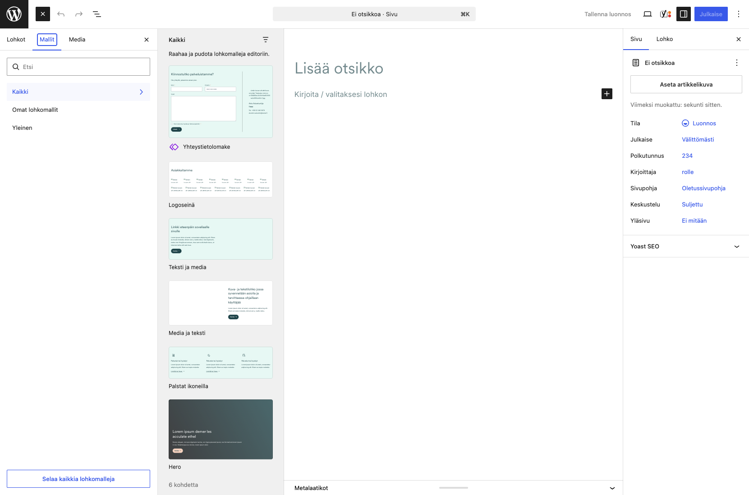
What does it look like?
Going ACF-free
Notes:
The client opens a new page, and the Patterns tab is already open.
The finished sections are right there. Drag one in and edit it.

Slide 41

Learning this with your AI
—
There are many ways to build a block and the docs are scattered, so AI gets it wrong too.
—
AI makes mistakes. It often writes a React.js block, because that is what the official Block Editor Handbook “Build your first block” tutorial with @wordpress/create-block teaches.
—
Tell it the order: core blocks, patterns, styles, and a custom block last.
—
Make it show the handbook page it used, learn, review, check the code before you ship it.
Going ACF-free
Notes:
AI is great for learning this, with one caution.
AI makes the same mistakes we did. Ask for a block and it often writes a full React block.
Give it the priority order first: core blocks, patterns, block styles, and a custom block last.
Ask it to show the handbook page behind the answer. Review the code like a colleague's code.

Slide 42
When ACF still makes sense
Settings pages
Relations
Advanced fields
With ACF, a page for site-wide settings takes a few lines. Without it, you code the whole page.
Linking posts together: ACF has a ready-made picker. With core it means coding it by hand.
Literally what the plugin was made for. If you need a field fast, ACF provides that for you.
Going ACF-free
Notes:
ACF is still the better choice in a few places.
Integrations: Polylang, FacetWP, Relevanssi and SEO plugins read ACF fields directly.
Settings pages: an ACF options page takes a few lines.
Relationships: ACF has a ready picker. Core stores the link but has no UI for it.
Structured data like product specs, opening hours and event dates needs a form.
The rule: pages and layouts with core blocks and patterns, structured data with the easiest form. Often that is still ACF.

Slide 43
Further reading
fullsiteediting.com
gutenberg.10up.com
Carolina Nymark’s lessons on blocks and block themes.
10up’s Block Editor Best Practices.
developer.wordpress.org/news
developer.wordpress.org/block-editor
The WordPress Developer Blog.
The Block Editor Handbook.
learn.wordpress.org
github.com/digitoimistodude/air-light
Free courses and lessons.
Our ACF-free WordPress starter theme for devs.
Going ACF-free

Slide 44
Kiitos.
Questions?
Rolle Laukkarinen
rolle.social · dude.fi · github.com/rollecode
Slides: github.com/rollecode/wpsuomi2026-talk-slides
Going ACF-free

